Slide 1
GENERATOR DESIGN: BENTHIC MICROBIAL FUEL CELLS for Long term Sensors Networks
Brandon Kelly
Mentored by dr. Jordon Beckler
FAU reu for renewable energy
7/7/2022

Slide 2
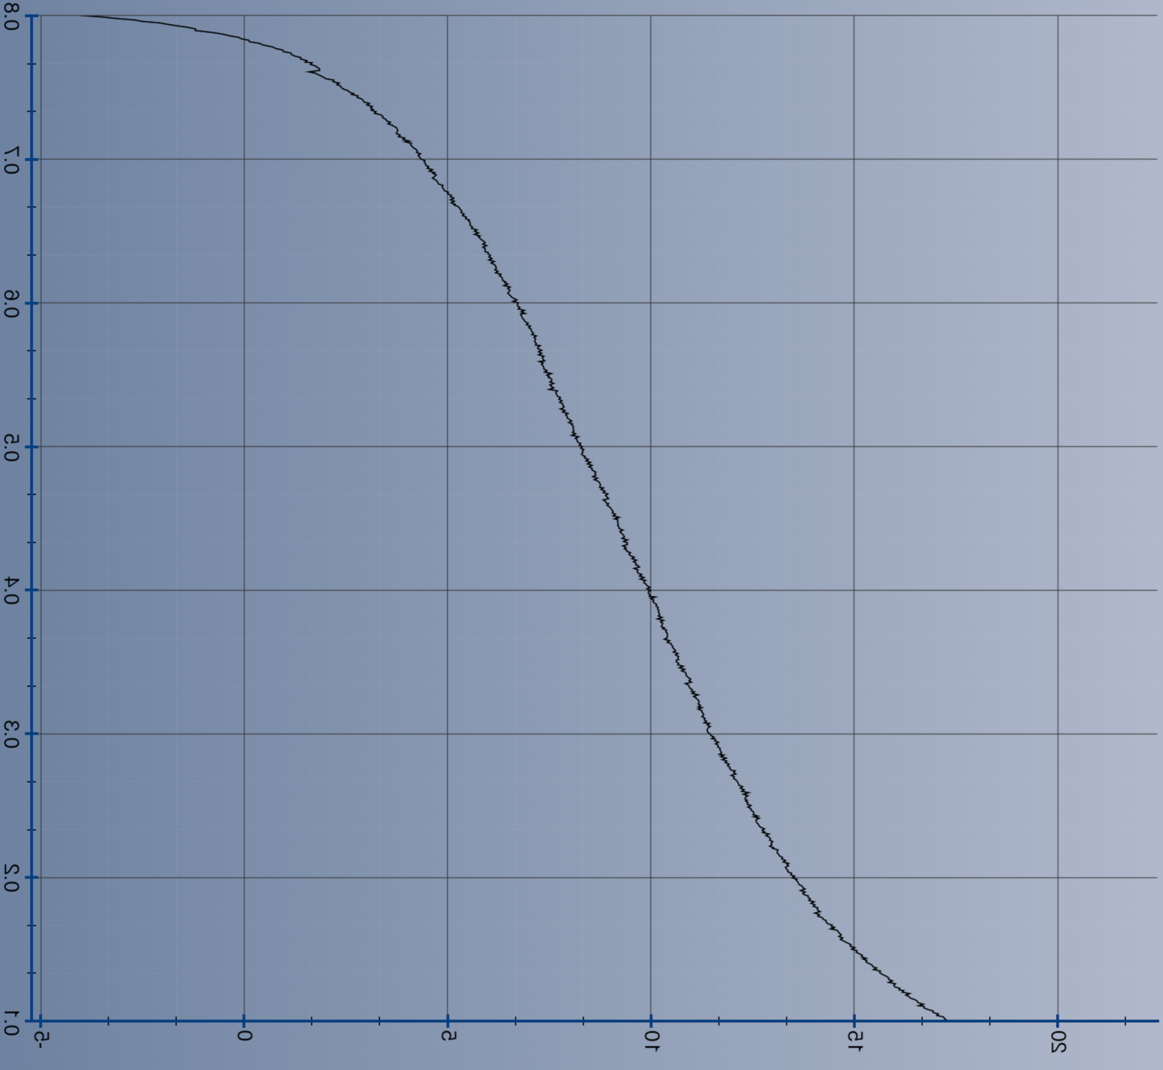
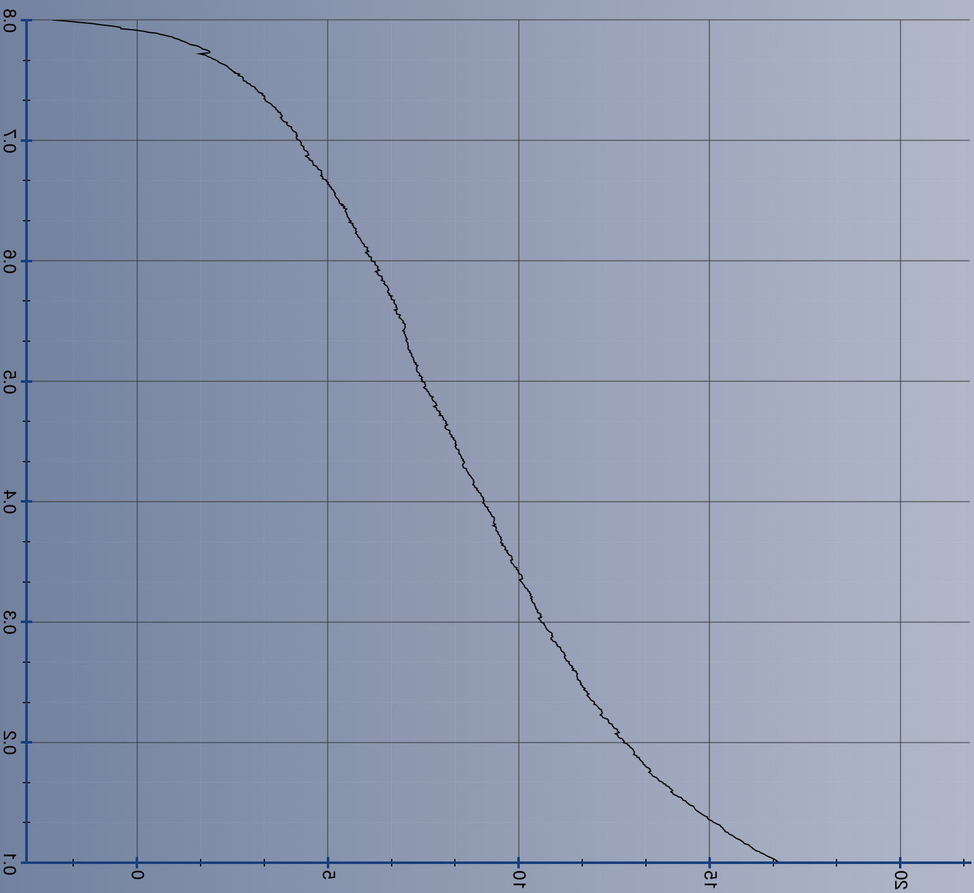

Polarization Curves
Battery 1
Battery 2
Voltage
(V)
Current (μA)
Current (μA)

Slide 3
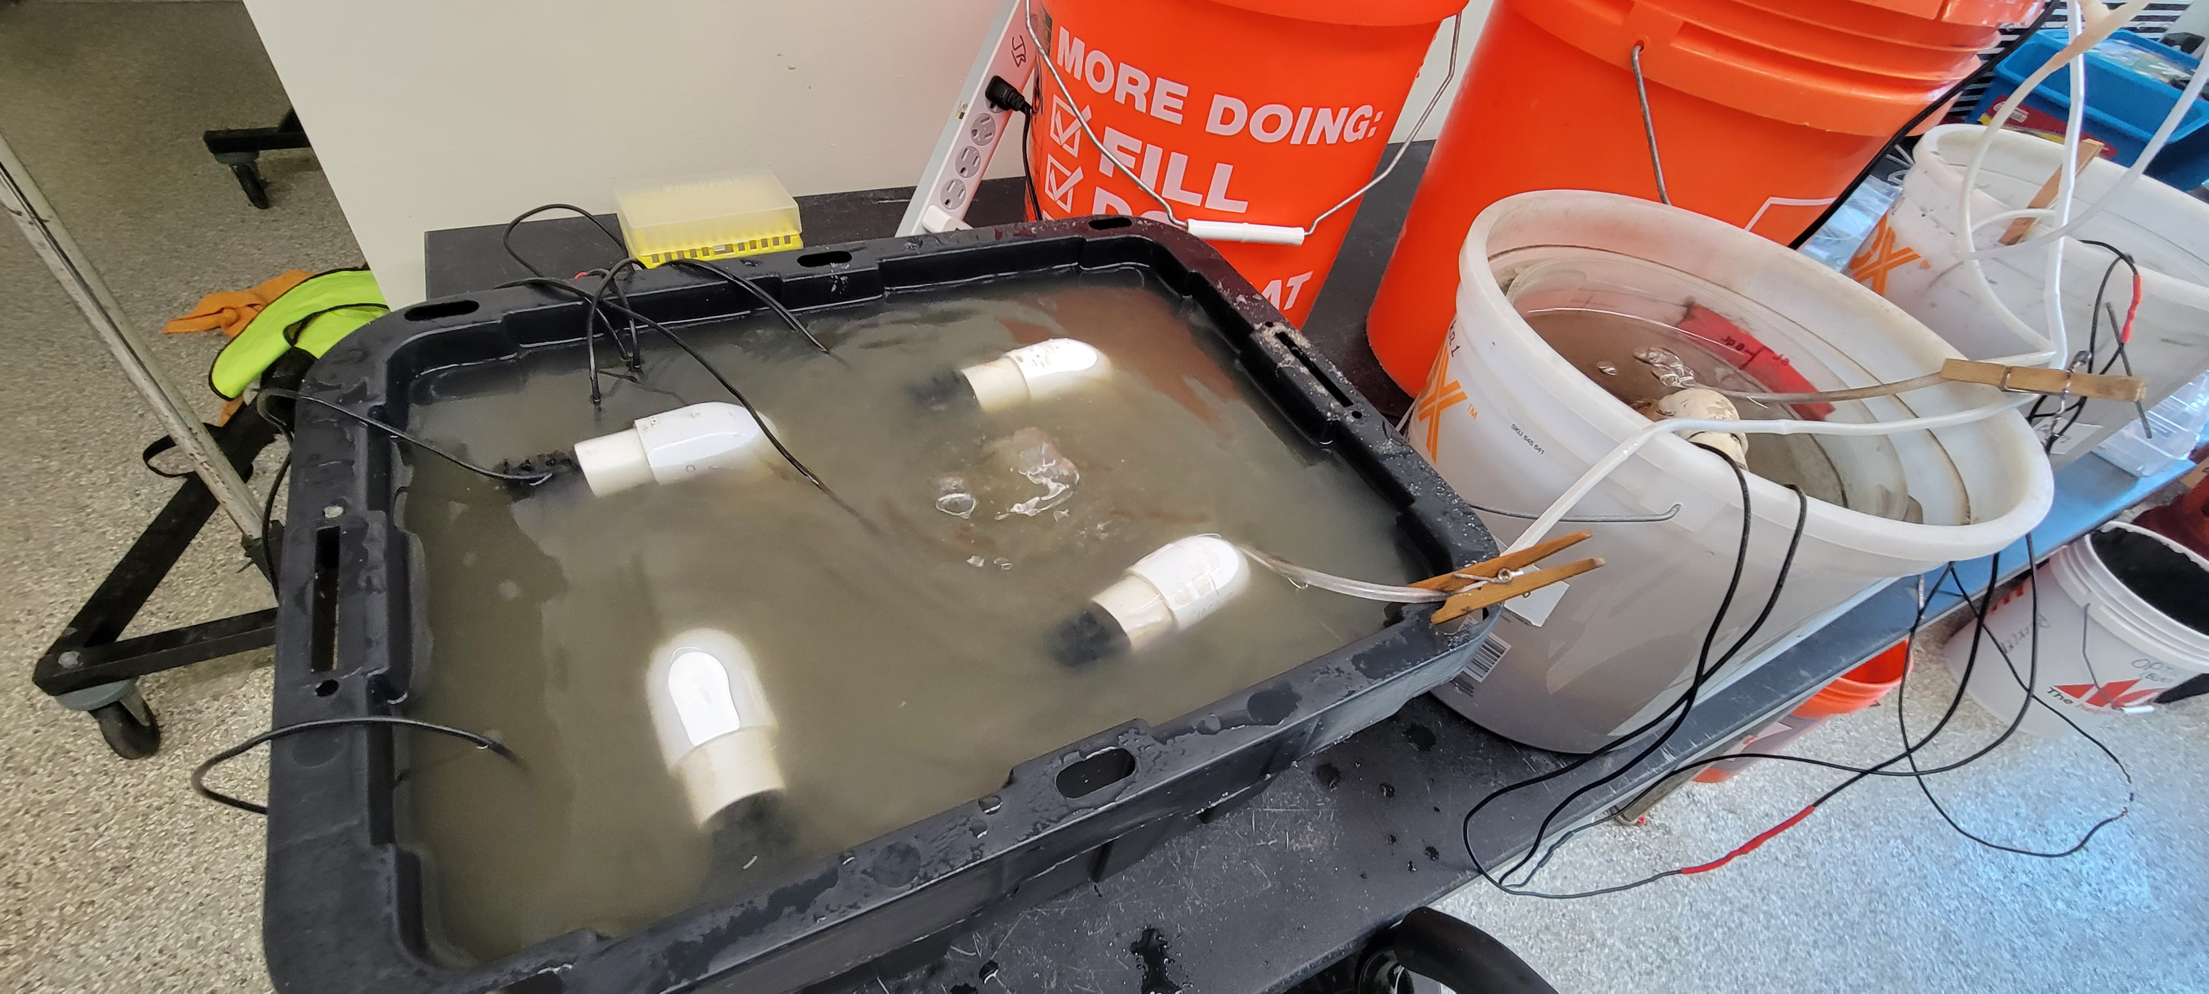

Arc Reactor

Slide 4
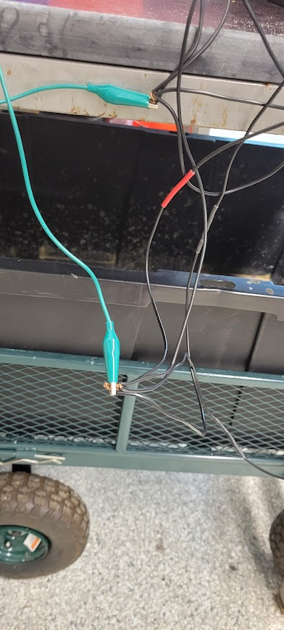
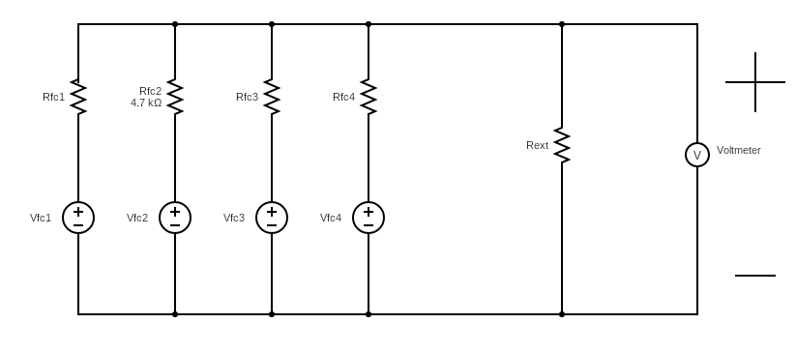
Wiring

Slide 5
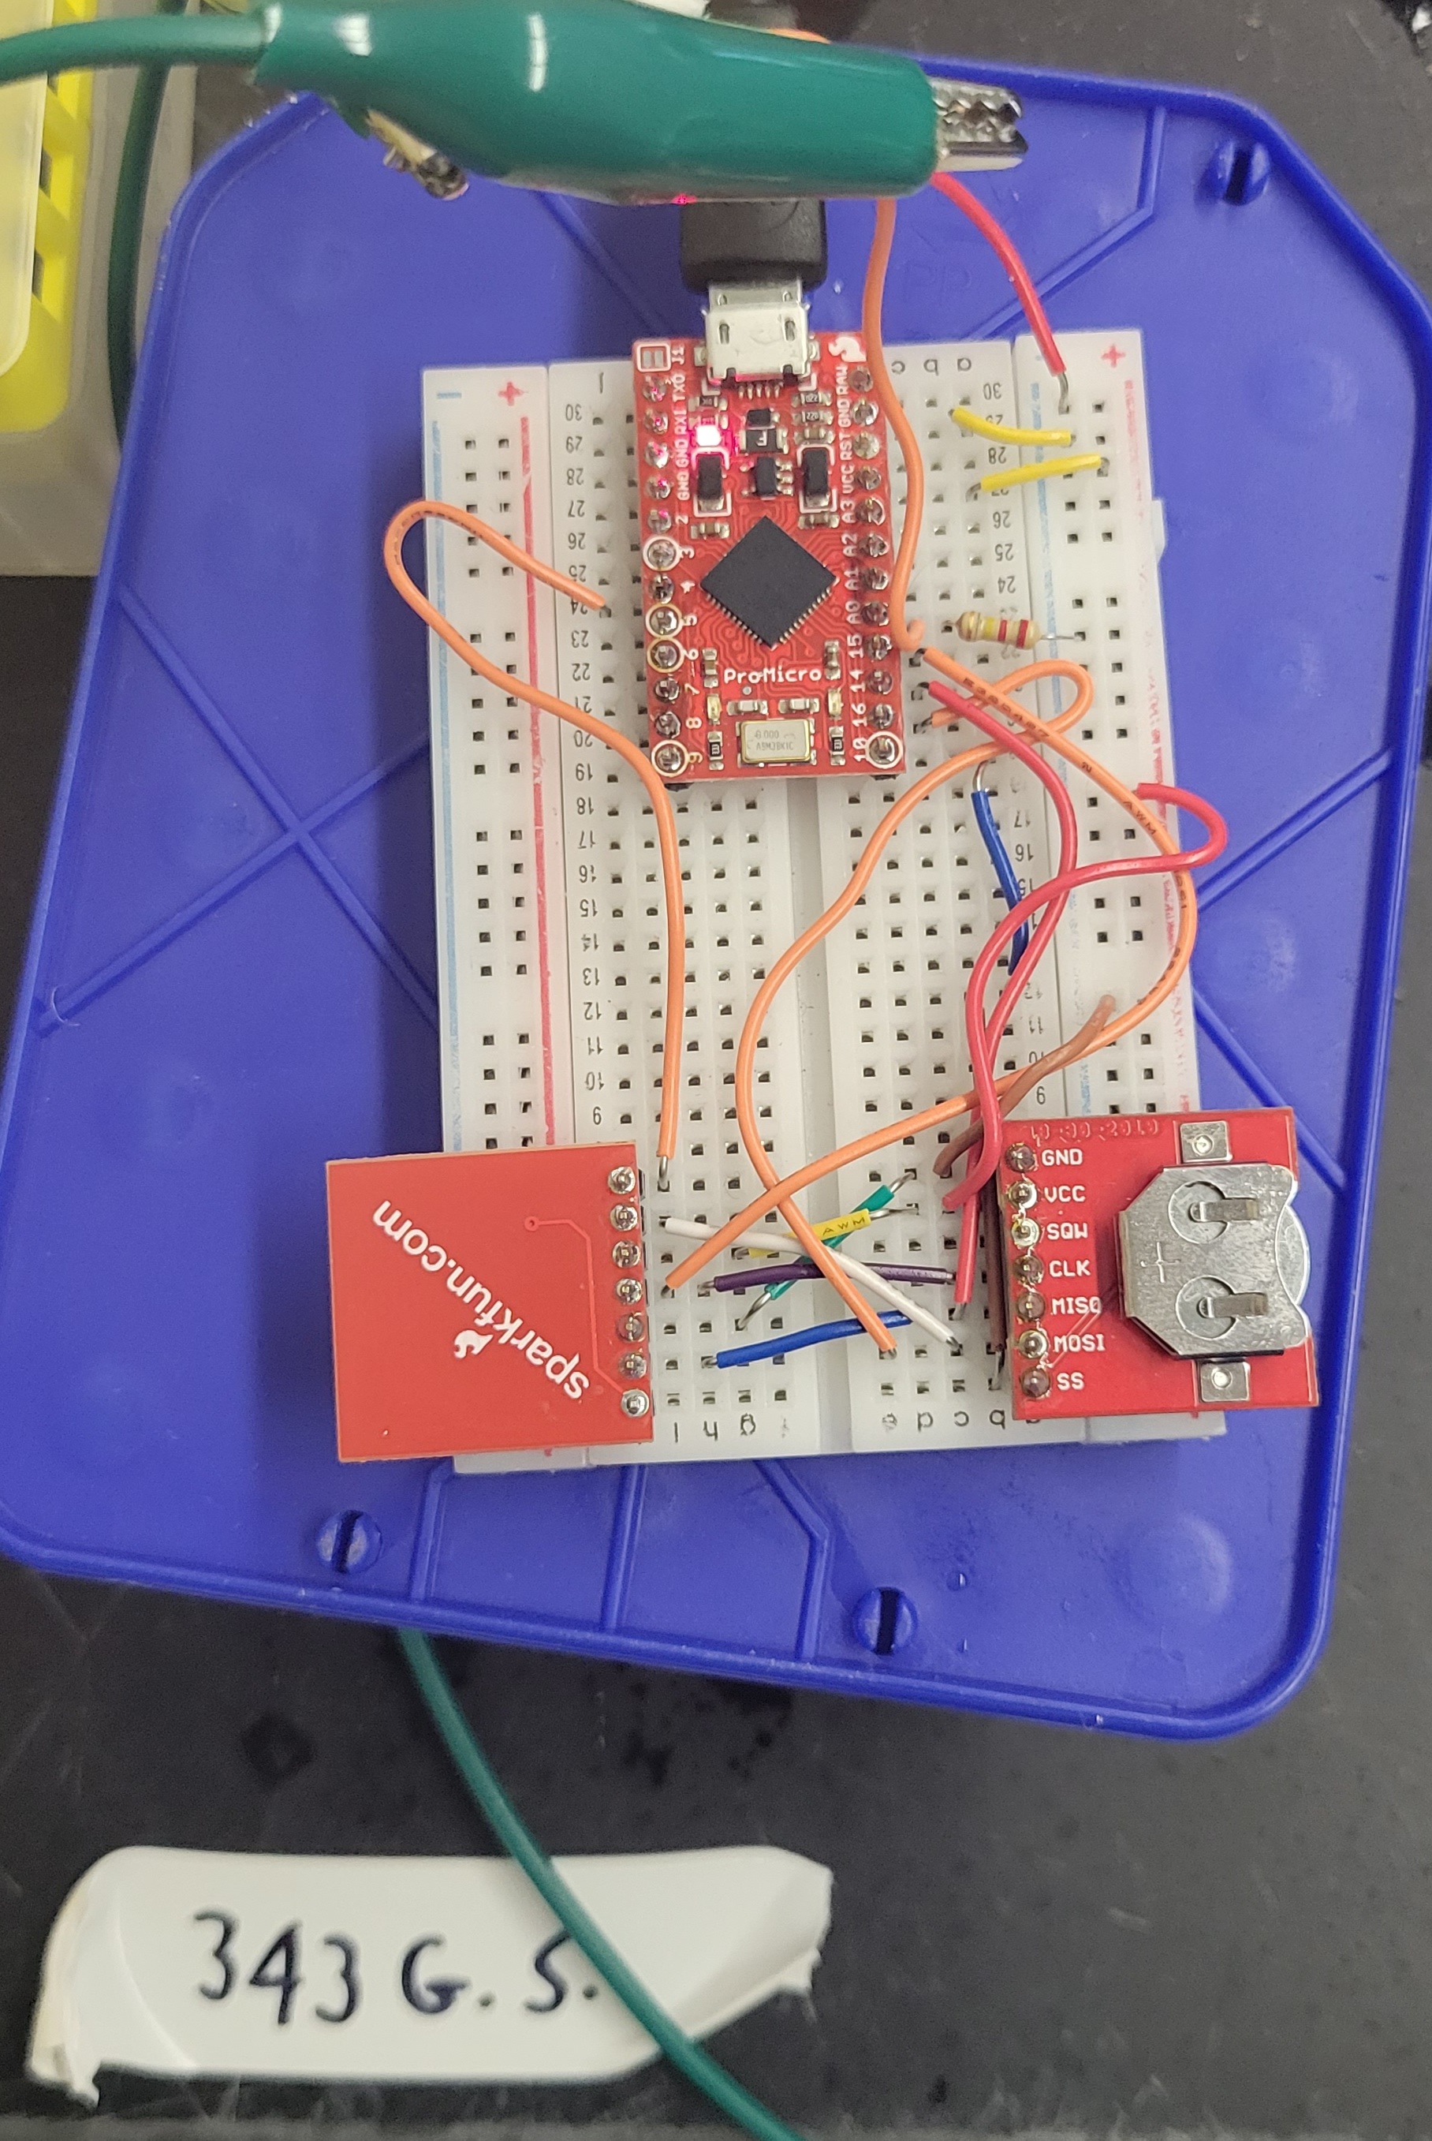

Data logging
Allows us to Track Voltage Over Time
Watch how System Responds in Real Time
Provides Data to Validate Models

